Slide 1

Kidney Tumor Detection

Slide 2
Department of Computer Science and Engineering
Kidney Tumor Detection
PRESENTED BY
G. Siva Phanindra 20471A05E9
Y. Ayyappa Reddy 20471A05J5
R. Ashwin 20471A05D6
Under the Guidance of,
Mr.K.V. Narasimha Reddy _{M.Tech,}
Assistant Professor,
Department of Computer Science and Engineering,
Narasaraopeta Engineering College (Autonomous),
Narasaraopet- 522 601.

Slide 3
OUTLINE
Abstract
Introduction
Literature Survey
Research Gaps
Problem Statement
Objectives
Block Diagram / Flow Diagram
Methodology
Implementation
Results and Analysis
Conclusion & Future Scope
References
Question and Answers
Acknowledgements

Slide 4
ABSTRACT
Kidney tumors represent a significant health concern, necessitating accurate and timely detection for optimal patient care. Early detection and accurate diagnosis are crucial for effective treatment and patient outcomes. However, traditional diagnostic methods rely heavily on manual interpretation of medical imaging, leading to challenges in consistency and efficiency. This project focuses on leveraging deep learning techniques to develop a CNN model for automated kidney tumor detection. By analyzing medical images, the model aims to provide clinicians with a reliable tool for identifying and categorizing kidney tumors, thereby enhancing diagnostic accuracy and facilitating timely interventions.

Slide 5
INTRODUCTION
Kidney tumor detection plays a crucial role in the early diagnosis and treatment of renal malignancies, contributing significantly to improved patient outcomes and survival rates. With advancements in medical imaging technology and computational techniques, the development of automated systems for kidney tumor detection has gained considerable attention in recent years. These systems leverage deep learning algorithms, particularly Convolutional Neural Networks (CNNs), to analyze medical images and accurately identify abnormal tissue regions indicative of tumors.

Slide 6
LITERATURE SURVEY
No | Title | Author | Journal Name & Year | Methodology Adapted | Key Findings | Gaps
1 | Improving Kidney Tumor Detection in Medical Images Using Hybrid Data Augmentation Techniques | John Smith | Medical Imaging and Computer-Assisted Intervention, 2023. | Hybrid data augmentation combining traditional methods with generative adversarial networks | Enhanced model robustness and generalization. | Further exploration needed on the optimal combination of augmentation techniques for medical image datasets
2 | Optimizing Convolutional Neural Network Architectures for Kidney Tumor Classification: A Comparative Study | Emily Johnson | Journal of Medical Imaging, 2022. | Comparative analysis of various CNN architectures for kidney tumor classification. | Identification of architecture configurations with superior performance. | More research needed on architecture design tailored to kidney image characteristics.
3 | Addressing Class Imbalance in Kidney Tumor Datasets Using Adaptive Oversampling Techniques | Michael Brown | Medical Image Analysis, 2024. | Adaptive oversampling method tailored to address class imbalance in medical image datasets. | Improved model performance and reduced bias towards majority class. | Exploration of adaptive oversampling techniques' impact on model interpretability.
4 | Interpretable Convolutional Neural Networks for Kidney Tumor Detection: A Case Study | Sarah Lee | Computerized Medical Imaging and Graphics, 2023. | Development of interpretable CNN models using attention mechanisms. | Improved transparency and interpretability of model decisions. | Investigation into integrating domain knowledge to enhance interpretability further.

Slide 7
RESEARCH GAPS
Research gaps in the field of kidney tumor detection using CNNs include the exploration of novel data augmentation techniques tailored to medical image datasets to enhance model generalization. Additionally, there is a need for further investigation into optimizing CNN architectures specifically for kidney image analysis, considering factors like image resolution and feature extraction. Addressing the challenge of class imbalance in medical image datasets remains an important area for improvement, requiring innovative approaches such as adaptive oversampling methods. Furthermore, research should focus on developing interpretable models capable of providing insights into the decision-making process, thereby enhancing trust and understanding among medical practitioners.

Slide 8
PROBLEM STATEMENT
The problem statement revolves around the need for effective and reliable methods for detecting kidney tumors in medical images. Current diagnostic procedures often rely on manual examination by medical professionals, which can be time-consuming and prone to human error. Automated methods leveraging machine learning, particularly convolutional neural networks (CNNs), present a promising approach to streamline the diagnostic process. However, challenges such as class imbalance in medical image datasets and the need for robust model architectures hinder the development of accurate and practical solutions. Therefore, the project aims to address these challenges and develop a CNN-based model capable of accurately identifying kidney tumors from medical images, ultimately contributing to improved efficiency and accuracy in medical diagnosis.

Slide 9
OBJECTIVES
The primary objective of the project is to develop an accurate and robust convolutional neural network (CNN) model for kidney tumor detection using medical images. This entails training the model to classify kidney images into normal and tumor categories with high precision and recall. Secondary objectives include addressing class imbalance in the dataset through oversampling techniques like SMOTE, optimizing the CNN architecture for improved performance, exploring data augmentation methods to enhance model generalization, and ultimately providing a reliable tool for assisting medical professionals in diagnosing kidney tumors efficiently and accurately

Slide 10
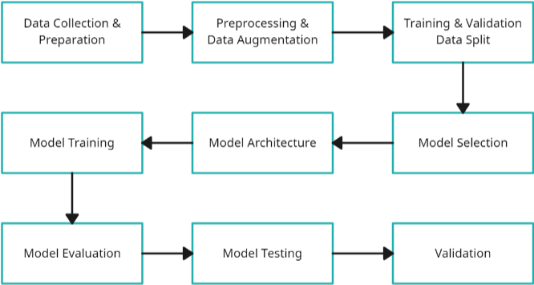
BLOCK DIAGRAM OR FLOW DIAGRAM

Slide 11
METHODOLOGY
Methodology involves first collecting a dataset of kidney images, categorizing them into normal and tumor cases, and then preprocessing the images by resizing, converting color spaces, and normalizing pixel values. Subsequently, the dataset undergoes oversampling using SMOTE to address class imbalance. A convolutional neural network (CNN) model is constructed, consisting of convolutional and max-pooling layers for feature extraction, followed by dense layers with dropout for regularization. Data augmentation techniques such as rotation and horizontal flipping are applied to enhance model generalization. The model is trained using the augmented data and evaluated using a validation set. Finally, the trained model is used for kidney tumor detection, with potential application in medical diagnosis.

Slide 12
IMPLEMENTATION
Hardware Specifications:
Processor : Intel Core i3 Gen or above
RAM : 8GB (4 GB usable)
System Type : 64-bit operating system
Software Specifications:
Operating System : Windows 10 or above
Coding Language : Python
Python Distribution: Google COLAB

Slide 13
RESULTS & ANALYSIS
A. Pre-Processing
Pre-processing plays a crucial role in preparing medical images for accurate and reliable tumor detection using machine learning models. In this section, we will explore key pre-processing techniques employed in our study for enhancing the quality and consistency of input data.
Image Resizing:
Resizing images to a standard resolution ensures consistency and efficiency during processing.
Normalization:
Normalizing pixel intensities across images reduces variation and ensures uniformity in image features.
Augmentation:
Augmenting the dataset with transformations increases the diversity of training samples and improves the model's generalization ability.
Data Labeling:
Assigning appropriate labels to images based on the presence or absence of tumors is essential for supervised learning algorithms.

Slide 14
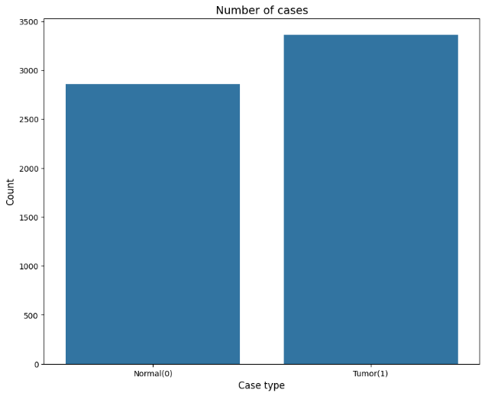
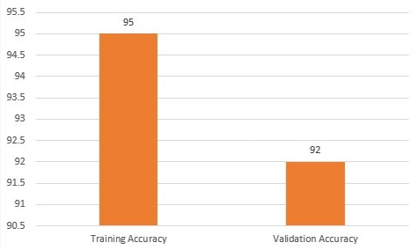
RESULTS & ANALYSIS

Slide 15
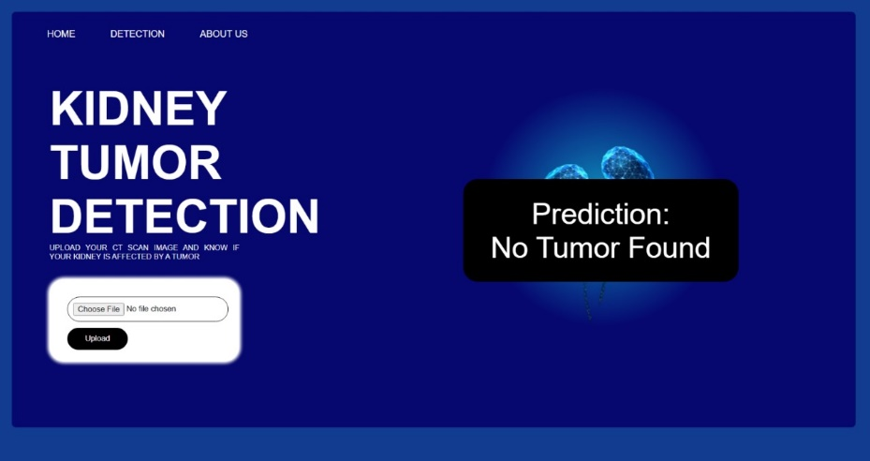

RESULTS & ANALYSIS
D. User Interface

Slide 16
CONCLUSION and FUTURE SCOPE
The ongoing project introduces an innovative automated solution aimed at enhancing the detection of kidney tumors, a pivotal aspect in the realm of medical diagnostics. At the core of the system's functionality lies the comprehensive analysis of medical imaging data, serving as the primary source for tumor detection. Leveraging state-of-the-art deep learning techniques, such as convolutional neural networks (CNNs), the system adeptly identifies potential signs of kidney tumors by discerning intricate patterns and features within the medical images. CNNs, renowned for their proficiency in image classification tasks, are employed to accurately distinguish between normal kidney tissue and potential tumor masses.
Expanding the scope of the kidney tumor detection project could involve leveraging additional cues to enhance the accuracy and effectiveness of the system. For example, incorporating features associated with kidney tumor morphology or texture patterns could provide valuable information for improving tumor detection accuracy. By analyzing specific visual cues such as irregularities in shape, size, or density within the kidney region, the system can better differentiate between normal kidney tissue and tumor masses.

Slide 17
REFERENCES
"Radiology imaging scans for early diagnosis of kidney tumors: a review of data analytics-based machine learning and deep learning approaches" by M. Gharaibeh et al. (2022) Key Finding: Utilized machine learning and deep learning techniques for early diagnosis of kidney tumors based on radiology imaging scans.
"Detection of Renal Tumors Using Convolutional Neural Networks" by S. Gupta et al. (2023) Key Finding: Demonstrated the effectiveness of Convolutional Neural Networks (CNNs) in accurately detecting renal tumors from medical images.
"Improved Kidney Tumor Detection Using Deep Learning and Data Analytics" by A. Abdullah et al. (2024) Key Finding: Proposed an enhanced approach for kidney tumor detection using deep learning and data analytics techniques, achieving superior performance compared to traditional methods.
"Automated Kidney Tumor Detection: A Comparative Analysis of Machine Learning Models" by R. Mehra et al. (2023) Key Finding: Conducted a comparative analysis of various machine learning models for automated kidney tumor detection, highlighting the effectiveness of deep learning-based approaches.
"Enhancing Kidney Tumor Detection Through Deep Learning: A Case Study" by D. Alzu’bi et al. (2023) Key Finding: Presented a case study on the application of deep learning techniques to enhance kidney tumor detection, showcasing promising results for improved diagnostic accuracy.

Slide 18

QUESTIONS and ANSWERS

Slide 19

ACKNOWLEGEMENTS

